Slide 1
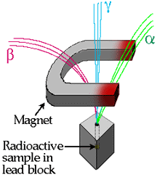
The 3 Radioactive particles

Slide 2
Pierre and Marie Curie discover 3 distinct types of accelerated particles from radioactive decay named after the first three letters of the Greek alphabet:
α(alpha), β(beta), and γ (gamma)
separated by a magnetic field, positive alpha particles bend one direction
negative beta particles bend opposite, neutral gamma rays do not bend at all
Alpha particles can be stopped by a sheet of paper, beta particles by aluminum, and gamma radiation by a block of lead. Gamma radiation can penetrate very far into a material, and so it is gamma radiation that poses the most danger when working with radioactive materials, although all types of radiation are very dangerous. Sadly, it took scientists many years to realize the perils of radioactivity...

Slide 3
α: Alpha particle: nucleus of helium (2 p, 2 n) ⁴He₂²
β: Beta particle: speedy electron
γ : Gamma radiation: bullets of light

Slide 4
Alpha
Alpha particles are the nuclei of helium atoms and are composed of two neutron and two protons. There speed is 10,000-20,000 miles per second. A thin sheet of paper can stop alpha particles
α

Slide 5
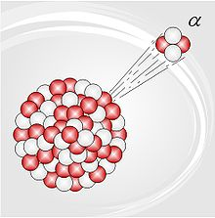
When an atom emits an alpha particle, the atom's mass number decreases by four due to the loss of the four nucleons in the alpha particle. The atomic number of the atom goes down by exactly two, as a result of the loss of two protons – the atom becomes a new element. Examples of this are when uranium becomes thorium, or radium becomes radon gas due to alpha decay.
Alpha particles are commonly emitted by all of the larger radioactive nuclei such as uranium, thorium, actinium, and radium, as well as the transuranic elements. Unlike other types of decay, alpha decay as a process must have a minimum-size atomic nucleus which can support it. The smallest nuclei which have to date been found to be capable of alpha emission are the lightest nuclides of tellurium (element 52), with mass numbers between 106 and 110. The process of emitting an alpha sometimes leaves the nucleus in an excited state, with the emission of a gamma ray removing the excess energy.

Slide 6
bETA
Beta particles are high speed electrons that shoot out from radioactive atoms. They have negative charge and can travel at speed of 60,000-160,000 miles per second.
β

Slide 7
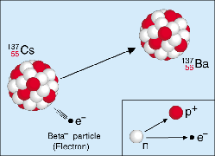
Beta emission is when a high speed electron (negative charge) leaves the nucleus. Beta emission occurs in elements with more neutrons than protons, so a neutron splits into a proton and an electron. The proton stays in the nucleus and the electron is emitted.

Slide 8
Gamma
Gamma particles are burst into photons emitted from electrons and are included in the electromagnetic spectrum. They travel at the speed of light. Thick layers of concrete or ;ead are required to stop gamma rays.
γ

Slide 9
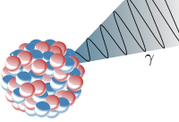
A nucleus which is in an excited state may emit one or more photons (packets of electromagnetic radiation) of discrete energies. The emission of gamma rays does not alter the number of protons or neutrons in the nucleus but instead has the effect of moving the nucleus from a higher to a lower energy state (unstable to stable). Gamma ray emission frequently follows beta decay, alpha decay, and other nuclear decay processes.

Slide 10
Separation of some radioactive emissions

